Slide 1
Digital Signal Processing
Lab 02: MATLAB Basics II
Abdallah El Ghamry

Slide 2
MATLAB
The purpose of this lab is to learn the basics of MATLAB including:
Scripts
Relational and Logic Operators
Selection Statements
Loop Statements
Vectorization
Functions
Anonymous Functions
Plotting

Slide 3
Scripts
A computer program is a sequence of instructions, in a given language, which accomplishes a task.
A script is a sequence of MATLAB instructions that is stored in a file with an extension of .m and saved.
The script can be executed, or run, by simply entering the name of the file (without the .m extension).
Before creating a script, make sure the Current Folder is set to the folder in which you want to save your files.

Slide 4
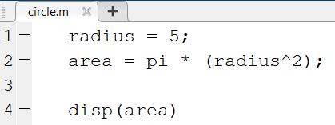
Scripts
In our first example, we will now create a script called circle.m that calculates the area of a circle.
It assigns a value for the radius, and then calculates the area based on that radius.
>> circle
78.5398

Slide 5
Relational and Logic Operators
Relational and logic operators are operators that produce a true or false result.
Relational operators are operators that compare two numbers and produce a true or false result.
For example, a > b is a relational operator.
Logic operators are operators that compare one or two logical values and produce a true or false result.
For example, && is a logical AND operator.

Slide 6
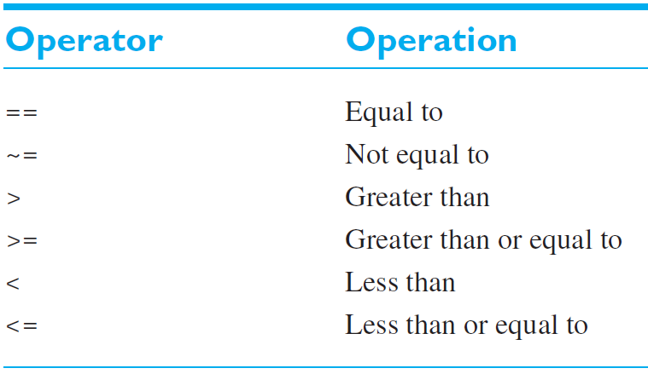
Relational Operators
Be careful not to confuse the equivalence relational operator (==) with the assignment operator (=).

Slide 7
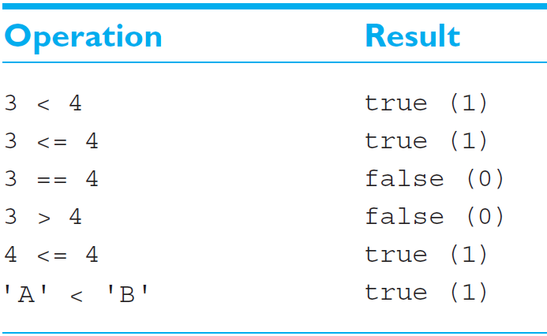
Relational Operators

Slide 8
Relational Operators With Arrays
>> a = [1 0; -2 1]
a =
1 0
-2 1
>> b = [0 2; -2 -1]
b =
0 2
-2 -1
>> a >= b
ans =
2×2 logical array
1 0
1 1

Slide 9
Relational Operators With Character Arrays and Strings
>> 'DSP' == 'DIP'
ans =
1×3 logical array
1 0 1
>> "DSP" == "DIP"
ans =
logical
0

Slide 10
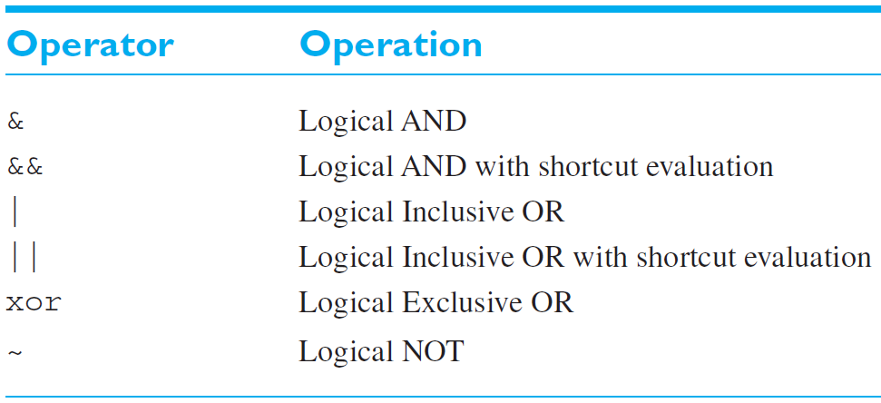
Logic Operators
There are two logical AND operators: && and &. Why?
There are two logical OR operators: || and |. Why?

Slide 11
Logic Operators
The && only works between scalar values.
While & works with either scalar or array values, as long as the sizes of the arrays are compatible.
The || only works between scalar values, while | works with either scalar or array values.
The & operator is preferred in most practical cases.
The result of XOR operator is true if and only if one operand is true and the other one is false.
The NOT operator (~) is a unary operator, having only one operand.

Slide 12
Logic Operators
>> a = [1 0; 1 1]
a =
1 0
1 1
>> b = [1 1; 0 1]
b =
1 1
0 1
>> a && b
Operands to the || and && operators must be convertible to logical scalar values.

Slide 13
Logic Operators
>> a = [1 0; 1 1]
a =
1 0
1 1
>> b = [1 1; 0 1]
b =
1 1
0 1
>> a & b
ans =
2×2 logical array
1 0
0 1

Slide 14
Selection Statements
Selection statements allows us to select and execute specific sections of code (blocks) while skipping other sections of code.
if expression
statements
elseif expression
statements
else
statements
end

Slide 15
Selection Statements: The if Statement
Determine if a value is nonzero.
x = 10;
if x ~= 0
disp('Nonzero value')
end

Slide 16
Selection Statements: The if-else Statement
Determine if a number is even or odd.
x = 4;
if mod(x, 2) == 0
disp("The number is even.")
else
disp("The number is odd.")
end

Slide 17
Selection Statements: The if-else Statement
% This script calculates the area of a circle
% It error-checks the user's radius
radius = input('Please enter the radius: ');
if radius <= 0
fprintf('Sorry; %.2f is not a valid radius\n', radius)
else
area = pi * radius ^ 2;
fprintf('The area is %.2f\n', area)
end

Slide 18
Selection Statements: The if-elseif-else Statement
Determine if a value falls within a specified range.
x = 10;
minVal = 2;
maxVal = 6;
if (x >= minVal) && (x <= maxVal)
disp('Value within specified range.')
elseif (x > maxVal)
disp('Value exceeds maximum value.')
else
disp('Value is below minimum value.')
end

Slide 19
Selection Statements: Quiz
Write a program that receives an integer quiz grade, which should be in the range from 0 to 10.
The function then returns a corresponding letter grade, according to the following scheme:
Also, the function returns the letter ‘X’ if the quiz grade is not valid.
Quiz | Grade
9 or 10 | A
8 | B
7 | C
6 | D
< 6 | F

Slide 20
Selection Statements: Quiz
quiz = input('Enter the score: ');
if quiz < 0 || quiz > 10
grade = 'X';
elseif quiz == 9 || quiz == 10
grade = 'A';
elseif quiz == 8
grade = 'B';
elseif quiz == 7
grade = 'C';
elseif quiz == 6
grade = 'D';
else
grade = 'F';
end
fprintf('Grade is %s\n', grade);

Slide 21
While Loops
The while statement is used as the conditional loop in MATLAB.
A while loop is a block of statements that are repeated indefinitely as long as some condition is satisfied.
The general form of the while statement is:
while condition
statements
end

Slide 22
While Loops
Display the numbers from 1 to 10.
n = 1;
while n <= 10
disp(n)
n = n + 1;
end

Slide 23
While Loops
Calculate the factorial of an integer.
n = input('Enter a positive integer: ');
ii = 1;
fact = 1;
while ii <= n
fact = fact * ii;
ii = ii + 1;
end
disp(fact)

Slide 24
Colon Operator
MATLAB provides a special shortcut notation using the colon operator.
The colon operator specifies a whole series of values by specifying the first value in the series, the stepping increment, and the last value in the series.
The general form of a colon operator is
first:incr:last

Slide 25
Colon Operator: Examples
>> x = 1:2:10
x =
1 3 5 7 9
>> y = 1:10
y =
1 2 3 4 5 6 7 8 9 10
>> z = 10:-2:0
z =
10 8 6 4 2 0

Slide 26
The for Loop
The for loop is a loop that executes a block of statements a specified number of times.
The general form of the for loop is:
for index = values
statements
end

Slide 27
The for Loop
Display the numbers from 1 to 10.
for n = 1:10
disp(n)
end
Display the numbers from 10 down to 1.
for n = 10:-1:1
disp(n)
end

Slide 28
The for Loop
Calculate the factorial of an integer.
n = input('Enter a positive integer: ');
fact = 1;
for ii = 1:n
fact = fact * ii;
end
disp(fact)

Slide 29
Nested Loops
It is possible for one loop to be inside another loop.
The following example shows two nested for loops used to calculate and write out the product of two integers.
for ii = 1:3
for jj = 1:3
product = ii * jj;
fprintf('%d * %d = %d\n', ii, jj, product);
end
end

Slide 30
The continue Statement
continue statement passes control to the next iteration of the loop.
The program continues execution from the next iteration.
An example of the continue statement in a for loop is as follows:
for n = [5 4 -2 7 -6 8]
if n < 0
continue
end
disp(n)
end

Slide 31
The break Statement
The break statement terminates the execution of the loop.
Statements in the loop after the break statement do not execute.
An example of the break statement in a for loop is as follows:
for n = [5 4 -2 7 -6 8]
if n < 0
break
end
disp(n)
end

Slide 32
Vectorization: A Faster Alternative to Loops
Many loops are used to apply the same calculations over and over to the elements of an array.
The following code fragment calculates the squares, square roots, and cube roots of all integers between 1 and 100 using a for loop.
for ii = 1:100
square(ii) = ii^2;
square_root(ii) = ii^(1/2);
cube_root(ii) = ii^(1/3);
end

Slide 33
Vectorization
The loop is executed 100 times, and one value of each output array is calculated during each cycle of the loop.
MATLAB offers a faster alternative for calculations: vectorization.
Instead of executing each statement 100 times, MATLAB can do the calculation for all the elements in an array in a single statement.
Because of the way MATLAB is designed, this single statement can be much faster than the loop and perform exactly the same calculation.

Slide 34
Vectorization
The following code fragment uses vectors to perform the same calculation as the loop shown previously.
We first calculate a vector of the indices into the arrays and then perform each calculation only once, doing all 100 elements in the single statement.
ii = 1:100;
square = ii.^2;
square_root = ii.^(1/2);
cube_root = ii.^(1/3);

Slide 35
Vectorization
v = 1:5
v =
1 2 3 4 5
>> v + 10
ans =
11 12 13 14 15
>> v * 2
ans =
2 4 6 8 10
>> sqrt(v)
ans =
1.0000 1.4142 1.7321 2.0000 2.2361

Slide 36
Vectorization
>> sum(1:10) % sum of intègres from 1 to 10
ans =
55
>> prod(1:5) % 5!
ans =
120
>> cos(0:pi:5*pi)
ans =
1 -1 1 -1 1 -1
>> power(2, 0:6)
ans =
1 2 4 8 16 32 64

Slide 37
Vectorization
>> m = [1 2; 3 4]
m =
1 2
3 4
>> m + 10
ans =
11 12
13 14
>> factorial(m)
ans =
1 2
6 24

Slide 38
Functions
All of the M-files that we have seen so far have been script files.
Script files are just collections of MATLAB statements that are stored in a file.
A script file has no input arguments and returns no results.
A function is a special type of M-file that runs in its own independent workspace.
It receives input data through an input argument list, and returns results to the caller through an output argument list.

Slide 39
Functions
The generic structure of a function is
function [outputVariables] = FunctionName(inputVariables)
Statements
...
return % Optional keyword
end

Slide 40
Functions: Euclidean Distance
The function dist2 calculates the distance between two
points (x1, y1) and (x2, y2) in a Cartesian coordinate system.
function distance = dist2(x1, y1, x2, y2)
distance = sqrt((x2-x1).^2 + (y2-y1).^2);
end
>> dist2(1, 1, 4, 5)
ans =
5

Slide 41
Functions: Area and Circum of Circle
Often, functions with multiple outputs are desired.
For example, suppose our function area_circ is to return two outputs:
area of the circle and the perimeter of the circle.
function [area, circum] = area_circ(r)
area = pi * r^2;
circum = 2 * pi * r;
end
>> [area, circum] = area_circ(5)
area = 78.5398
circum = 31.4159

Slide 42
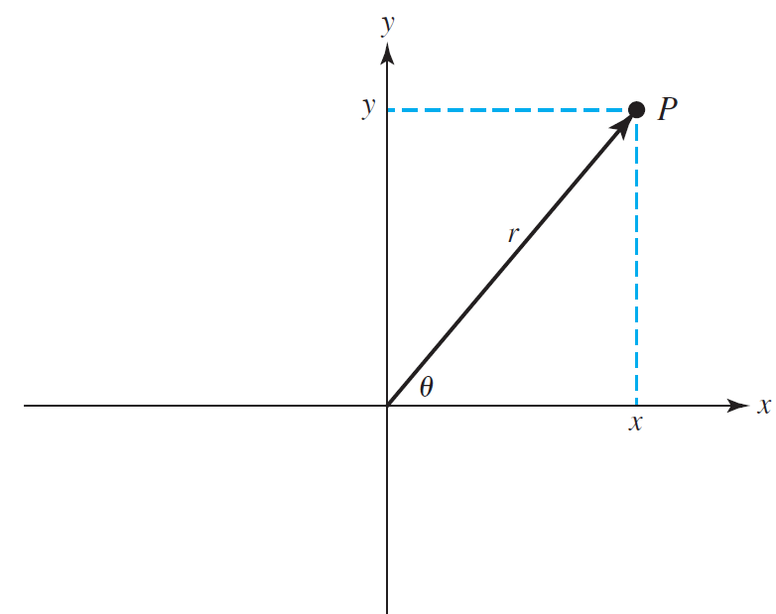
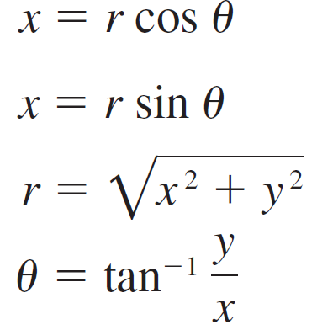
Functions: Rectangular-to-Polar Conversion
The location of a point in a Cartesian plane can be expressed in either the rectangular coordinates (x, y) or the polar coordinates (r, θ).
The relationships among these two sets of coordinates are given by the following equations:

Slide 43
Functions: Rectangular-to-Polar Conversion
function [r, theta] = rect2polar(x, y)
r = sqrt(x.^2 + y .^2);
theta = 180/pi * atan2(y, x);
end
>> [r, theta] = rect2polar(4, 3)
r =
5
theta =
36.8699

Slide 44
Anonymous Functions
An anonymous function is a function that is not stored in a file.
It is associated with a variable whose data type is function_handle.
Anonymous functions can accept multiple inputs and return one output.
They can contain only a single executable statement.
An anonymous function that finds the square of a number:
>> sqr = @(x) x.^2;
>> sqr(5)
ans =
25

Slide 45
Anonymous Functions: Sinusoidal Signals
Some signals can be described analytically.
For example, the function x (t) describes a sinusoidal signal:
x (t) = 5 sin (12t)
>> x = @(t)(5*sin(12*t))
x =
function_handle with value:
@(t)(5*sin(12*t))
>> x(5)
ans =
-1.5241

Slide 46
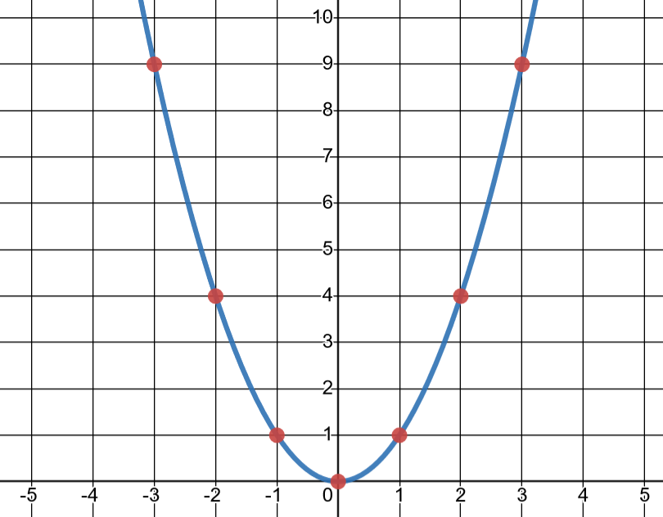
Plotting
f (x) = x²
x | -3 | -2 | -1 | 0 | 1 | 2 | 3
f (x) | 9 | 4 | 1 | 0 | 1 | 4 | 9

Slide 47
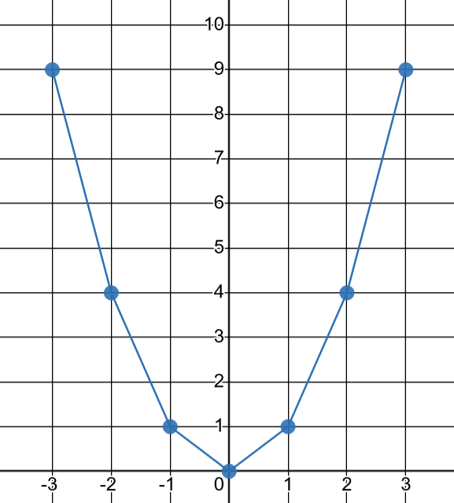
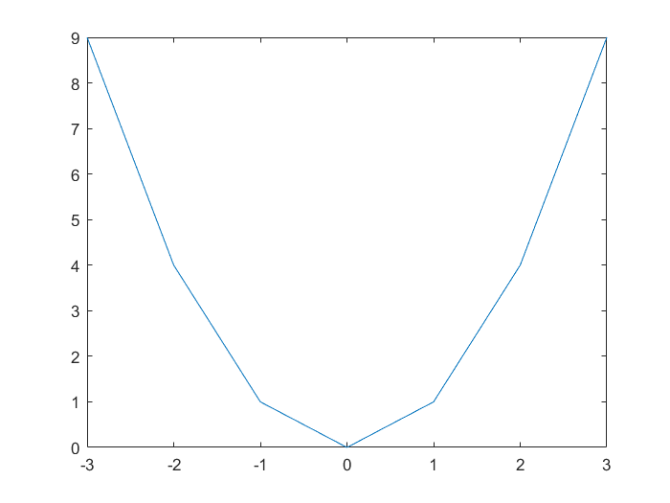
Plotting
x = -3:3;
y = x.^2;
plot(x, y);

Slide 48
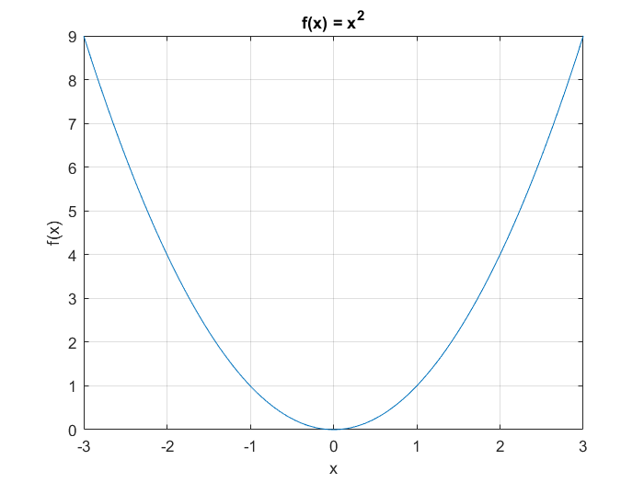
Plotting
x = -3:0.1:3;
y = x.^2;
plot(x, y);

Slide 49
Plotting
x = linspace(-3, 3, 100);
y = x.^2;
plot(x, y);
title('f(x) = x^2');
xlabel('x');
ylabel('f(x)');
grid on;

Slide 50
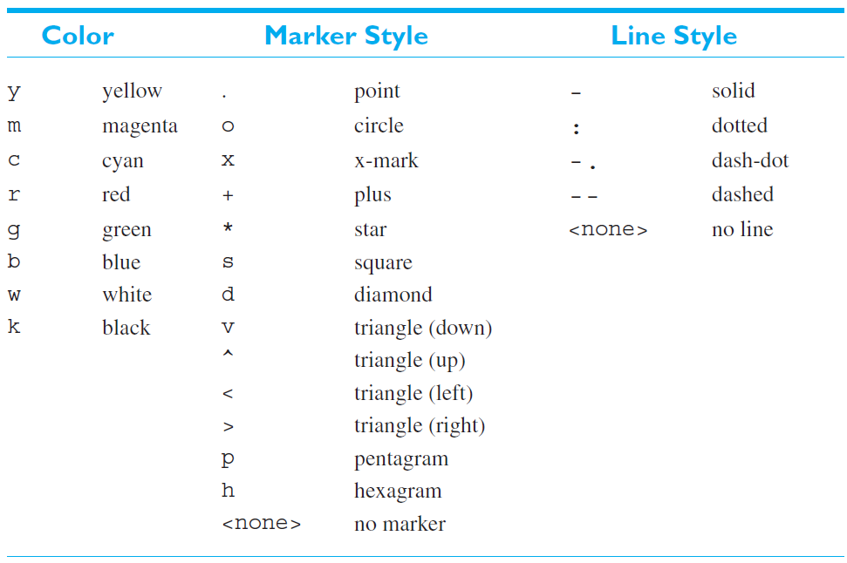
Plotting: Plot Colors, Marker Styles, and Line Styles

Slide 51
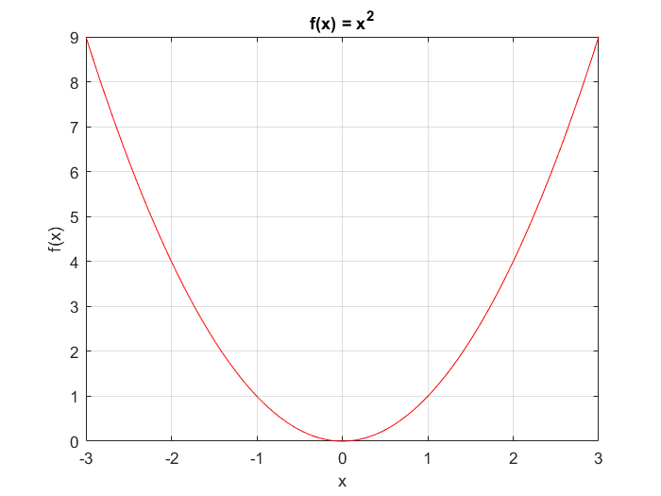
Plotting: Plot Colors, Marker Styles, and Line Styles
x = linspace(-3, 3, 100);
y = x.^2;
plot(x, y, 'r');
title('f(x) = x^2');
xlabel('x');
ylabel('f(x)');
grid on;

Slide 52
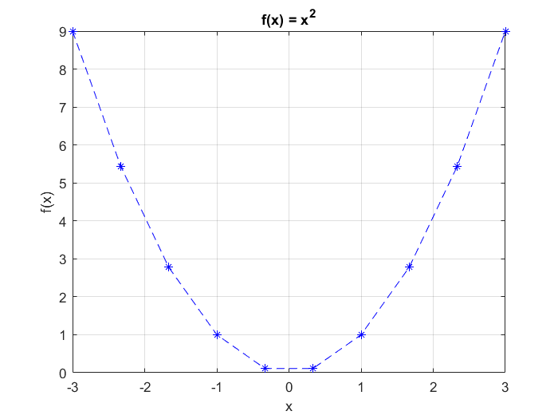
Plotting: Plot Colors, Marker Styles, and Line Styles
x = linspace(-3, 3, 10);
y = x.^2;
plot(x, y, 'b*--');
title('f(x) = x^2');
xlabel('x');
ylabel('f(x)');
grid on;

Slide 53
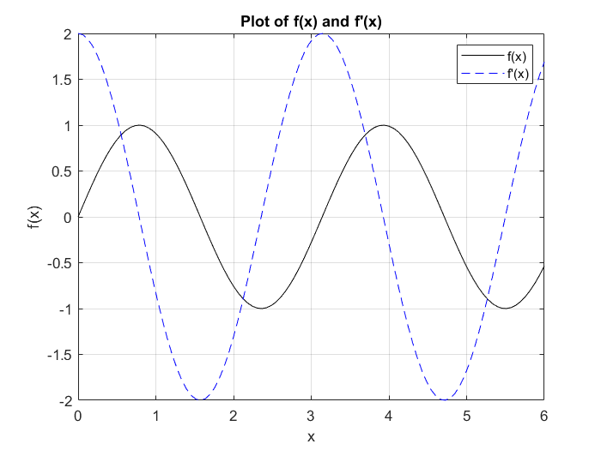
Plotting: Multiple Functions
x = linspace(0, 6, 100);
y1 = sin(2*x);
y2 = 2*cos(2*x);
plot(x, y1, 'k', x, y2, 'b--');
title("Plot of f(x) and f'(x)");
xlabel('x');
ylabel('f(x)');
legend("f(x)", "f'(x)");
grid on;

Slide 54
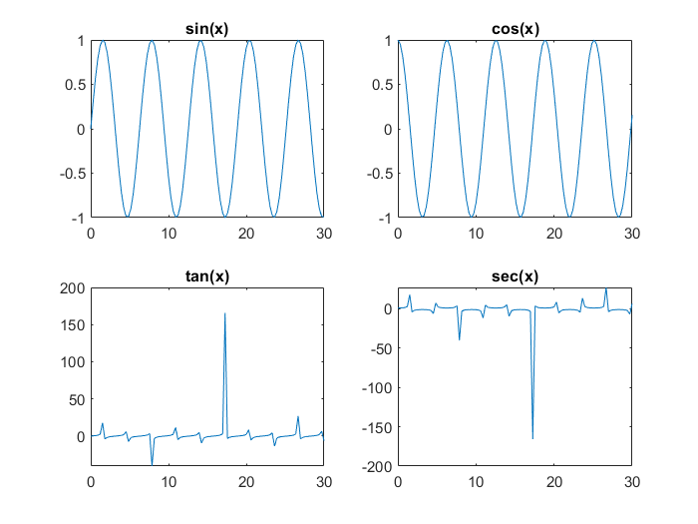
Plotting: Subplots
subplot(2, 2, 1);
x = linspace(0, 30);
y1 = sin(x);
plot(x, y1);
title('sin(x)');
subplot(2, 2, 2);
y2 = cos(x);
plot(x, y2);
title('cos(x)');
subplot(2, 2, 3);
y3 = tan(x);
plot(x, y3);
title('tan(x)');
subplot(2, 2, 4);
y4 = sec(x);
plot(x, y4);
title('sec(x)');

Slide 55
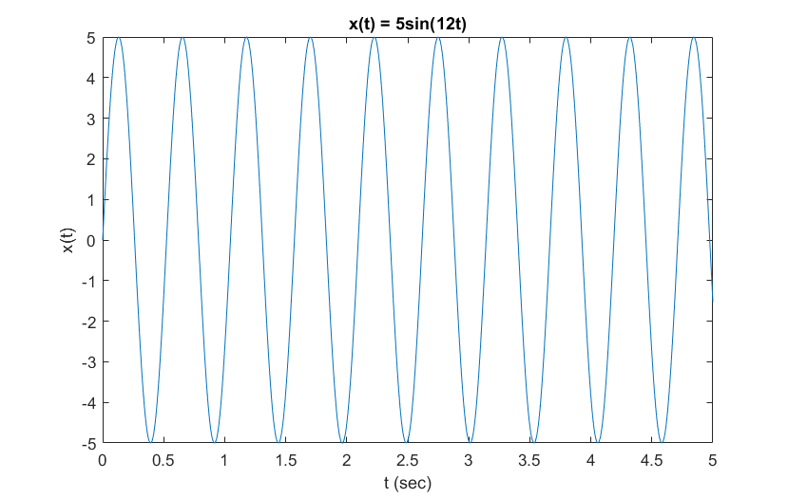
Plotting: Graphing Signals
The function x (t) describes a sinusoidal signal
x (t) = 5 sin (12t)
t = linspace(0, 5, 1000);
x = 5*sin(12*t);
plot(t, x);
title('x(t) = 5sin(12t)');
xlabel('t (sec)');
ylabel('x(t)');

Slide 56
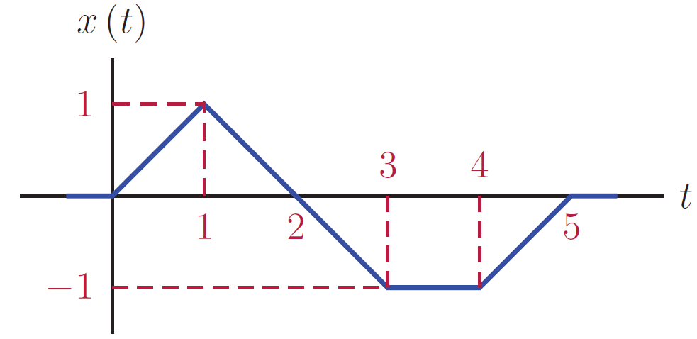
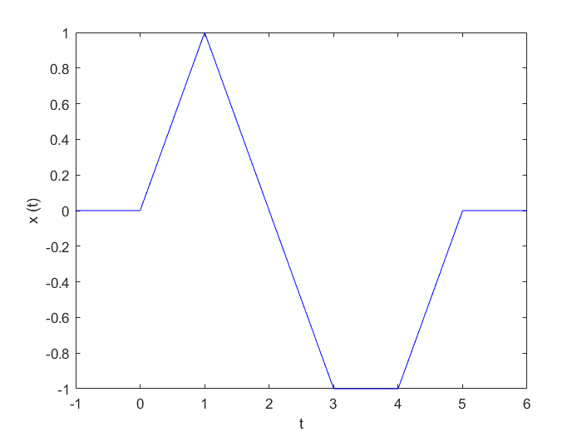
Plotting: Graphing Signals
Consider the following signal.
t = [-1, 0, 1, 3, 4, 5, 6];
x = [0, 0, 1, -1, -1, 0, 0];
plot(t, x, 'b');
xlabel('t');
ylabel('x (t)');

